Slide 1
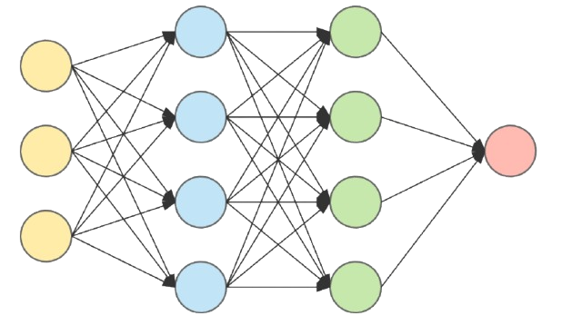
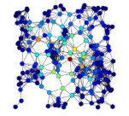


Actor Network
(64→ 32 MLP)
FP32 weights
Fake-Quantization(FQ) In the Graph
Quantization weights and Activations
FQ
:
FQ
FQ
:
:
FQ
FQ
INT8 Weights
INT8 Activations
QAT Conditions the Weights
So The accuracy loss is minimal
QAT Quantization Module
Critics( Training Only )
Are not quantized and never leave the training Machine
Calibration Data (From Training)
Fine tuning with quantization error in the loop so weights adapt to it
Conversion Path
ai
Replay Buffer
(State seen during Training)
Uniform random states(fallback)
ai_edge_torch/LiteRT Quantizer
.tflite
(INT8)
Pytorch PT2E export
Calibrated on the states the policy actually visits
Fallback (if PT2E annotation not available ):
XNNPACK symmetric-quantization route

